Slide 1

Dr. Ammar Haider
Assistant Professor
School of Computing
CS3002 Information Security
Public Key Infrastructure
Reference: Stallings SPP chap 23

Slide 2
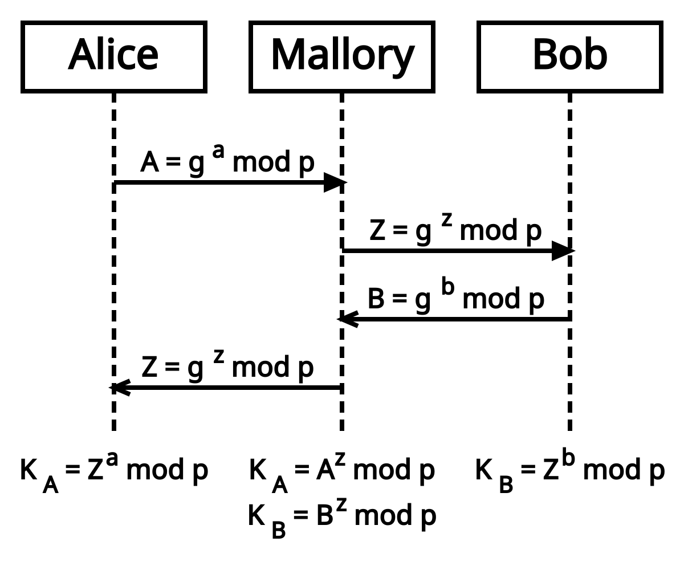
MITM against Diffie-Hellman
Recap: Diffie-Hellman key exchange is vulnerable to main in the middle attack
https://commons.wikimedia.org/wiki/File:Man-in-the-middle_attack_of_Diffie-Hellman_key_agreement.svg

Slide 3
MITM in PKC
MITM is not unique to Diffie-Hellman key exchange
All kinds of asymmetric crypto (RSA, digital signatures, digital envelope etc.) is vulnerable to such attacks
Whenever public keys are exchanged over an insecure channel, we can not blindly trust the received public key.

Slide 4
Public-Key Certificates
To prevent MITM against PKC, digital certificates are used.
A certificate associates a public key with an individual/company
Digital certificate is just a piece of data
A public key and ID of key owner, whole block signed by a trusted third party
Issued by a Certificate Authority (CA)
Helps in authentication

Slide 5
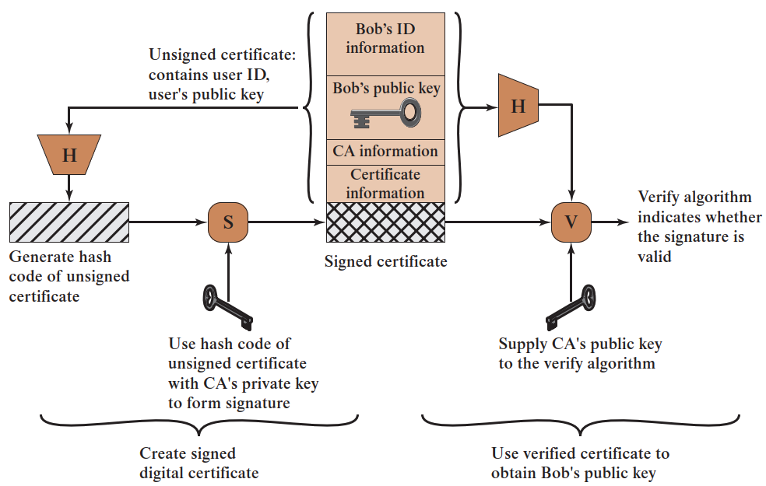
Public-Key Certificate
Signing a certificate by CA

Slide 6
Public-Key Certificate
Contains the following information:
who issued the certificate: Comodo, Symantec etc.
who the certificate is issued to (aka subject)
public key of the owner
validity period
digital signature by CA
X.509: International Standard for the format of a public-key certificate

Slide 7
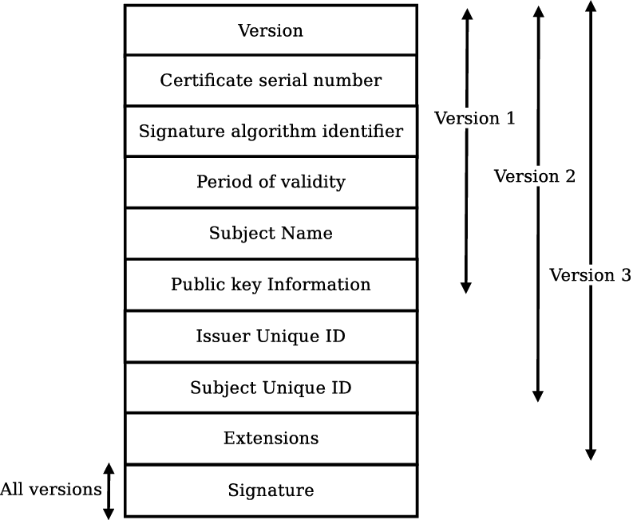
X.509 Identity Certificates
Distinguished Name of user
C=US, O=Lawrence Berkeley National Laboratory, OU=DSD, CN=Mary R. Thompson
DN of Issuer
C=US, O=Lawrence Berkeley National Laboratory, CN=LBNL-CA
Validity dates:
Not before <date>, Not after <date>
User's public key
V3 extensions
CA signatures
Defined in ASN.1 notation
language independent

Slide 8
Public Key Infrastructure (PKI)
PKI is the set of hardware, software, and procedures needed to create, store, distribute and revoke digital certificates
Elements of PKI
X.509 Certificates
Certificate Authorities (CA)
Registration Authorities (RA)
Public/Private Key Pairs
Certificate Revocation Lists

Slide 9
Certificate Authority
A third party. Must be a secure server
Signs and publishes X.509 Identity certificates
Revokes certificates and publishes a Certification Revocation List (CRL)
Anyone can sign certificates (act as CA), but their certificates will have no value unless the users trust them.
Trusting means the certificate inspector (receiver) already knows about this CA, and has pre-saved the CA’s public key in its records.
so that they can verify CA’s signatures

Slide 10
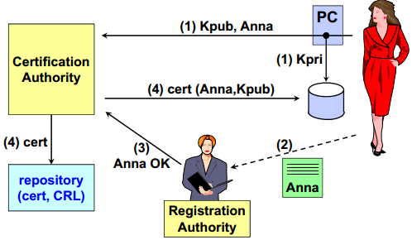
Certificate Issuance Process

Slide 11
Registration Authority
An RA is responsible for accepting requests for digital certificates and authenticating the entity making the request.
You provide RA with information and fees
RA verifies the information before the CA issues the certificate
RA does not sign the certificate
Your key pair maybe created by RA or yourself

Slide 12
Trusted CAs
All operating systems come with a pre-installed list of trusted CAs.
There are several vendors
IdenTrust
DigiCert
Sectigo (Comodo)
Lets Encrypt: issues free certificates
OpenSSL is a free and open source library. It can be used to setup your own CA server.

Slide 13
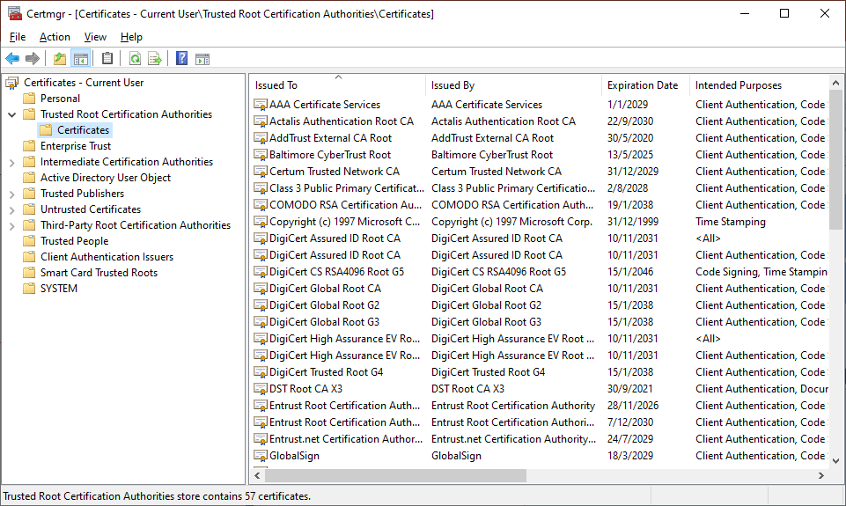
Trusted CAs – Check your PC
Windows: launch Certmgr.msc
All trusted authorities are present in system’s certificates store, aka trust store.
This is a highly security-critical component of system. What would happen if attackers could manipulate the certificate store?

Slide 14
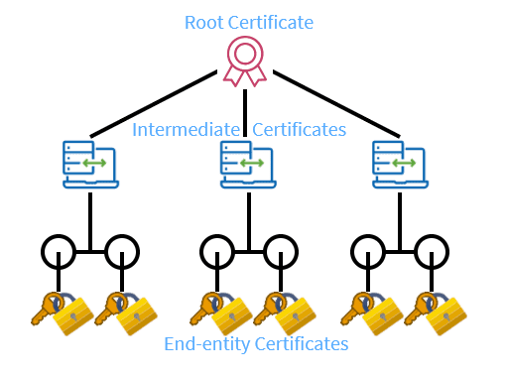
Chain of Trust
Instead of getting a certificate directly from a root CA, it is more practical to get one from an intermediate CA which already has a certificate from root CA.
This hierarchy can go many levels deep

Slide 15
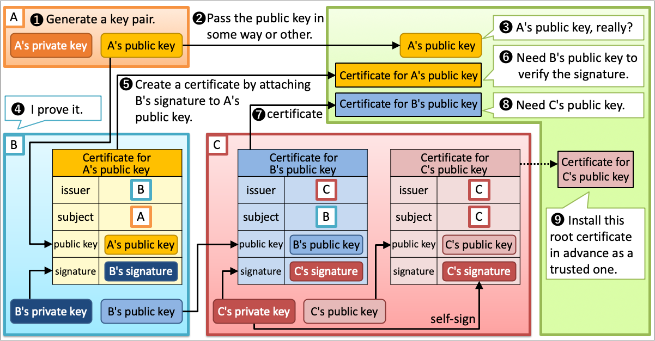
Chain of Trust
https://darutk.medium.com/illustrated-x-509-certificate-84aece2c5c2e

Slide 16
Certificate Revocation List (CRL)
Certificates may need to be revoked (prior to expiration) for several reasons
Subject may request revocation because
Subject’s private key was compromised
HR reasons, e.g. employee left the company
Temporary revocation (on “hold”) e.g. resource on leave
Subject changed names, physical address, DNS
CA themselves may decide to revoke because
Subject provided false information
CA’s private key was compromised!
CAs maintain lists of revoked/cancelled certificates. These lists are published by CA frequently

Slide 17
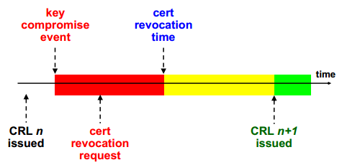
Certificate Revocation Timeline

Slide 18
CRL Drawbacks
Certificate revocation lists
Too much work on the client
Too much traffic on internet
Not used
Alternate: Online Certificate Status Protocol
CA’s always-online revocation server
Provides current information
Saves traffic on the internet

Slide 19
OCSP
Online certificate status protocol
IETF-PKIX standard to verify online if a certificate is valid:
good/verified
revoked
revocation time
revocation reason
unknown
response must be signed by the responder server (not by the CA!)
the OCSP server certificate cannot be verified with OCSP itself!

Slide 20
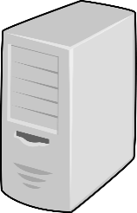

OCSP Usage
subject server
e.g. youtube.com
a. request certificate for public key A
CA server
b. issue cert-A
end user
OCSP responder
Ahead of time
At communication time

Slide 21
OCSP Usage
subject server
e.g. youtube.com
a. request certificate for public key A
CA server
b. issue cert-A
1. request certified public key
2. here is cert-A
end user
OCSP responder
Ahead of time
At communication time

Slide 22
OCSP Usage
subject server
e.g. youtube.com
a. request certificate for public key A
CA server
b. issue cert-A
1. request certified public key
2. here is cert-A
end user
OCSP responder
3. ✔ not expired and signed by a trusted CA
Ahead of time
At communication time

Slide 23
OCSP Usage
subject server
e.g. youtube.com
a. request certificate for public key A
CA server
b. issue cert-A
1. request certified public key
2. here is cert-A
4. check revocation of cert-A
end user
OCSP responder
5. cert-A revoked two days ago
3. ✔ not expired and signed by a trusted CA
Ahead of time
At communication time

Slide 24
OCSP Usage
subject server
e.g. youtube.com
a. request certificate for public key A
CA server
b. issue cert-A
d. issue cert-X
1. request certified public key
c. request cert for public key X
2. here is cert-A
4. check revocation of cert-A
end user
OCSP responder
5. cert-A revoked two days ago
Must be a signed response
3. ✔ not expired and signed by a trusted CA
Ahead of time
At communication time

